Slide 1
Baystate Banner LatinX
Ngozi Omatu, Song Xie, Matan Ziegel, Gil Lotzky, Anna Xie

Slide 2

How have LatinX voting patterns changed from 2016 to 2020?
Project Goals:
Analyzing whether there was a significant difference in LatinX voting patterns
Understanding how changes in LatinX demographics may impact election results for each city (based on correlation)
Motivations:
Do towns with a significant LatinX population tend to favor one political party over another?
Given what has happened over the past 4 years, was there a change in the LatinX voting patterns?
Notes:
The goals of project is to determine and analyze if there is any significant difference between voting patterns in LatinX population from 2014 to 2020
Also to understand how these changes in LatinX voting pattern may impact the election result for cities with majority LatinX and non-latinX population
For the motivation of this project:
Our Client ( Yawu) wanted to know understand the component for support of Replublican votes in MA over the past 6 years . Because of this, we want to know if towns with a significant LatinX population tend to favor one political party over another. Has there been any changes to the latinX voting pattern over the past 4 years?

Slide 3
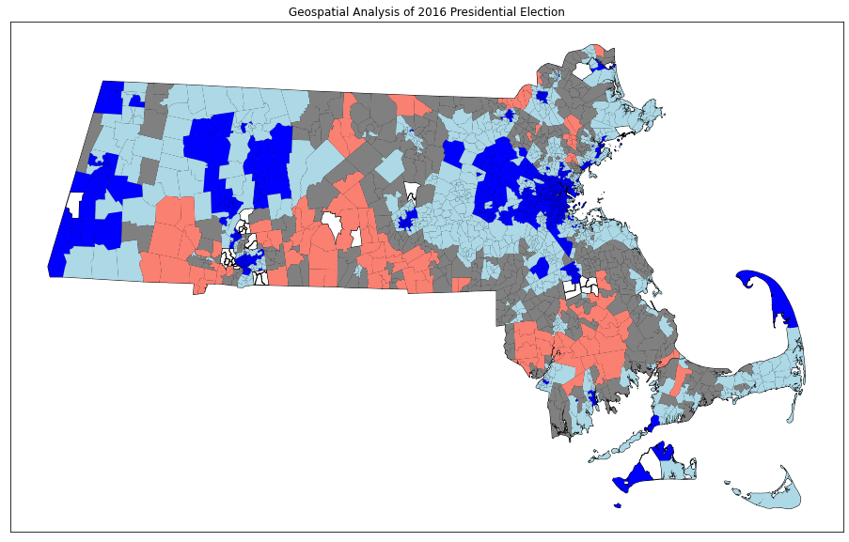
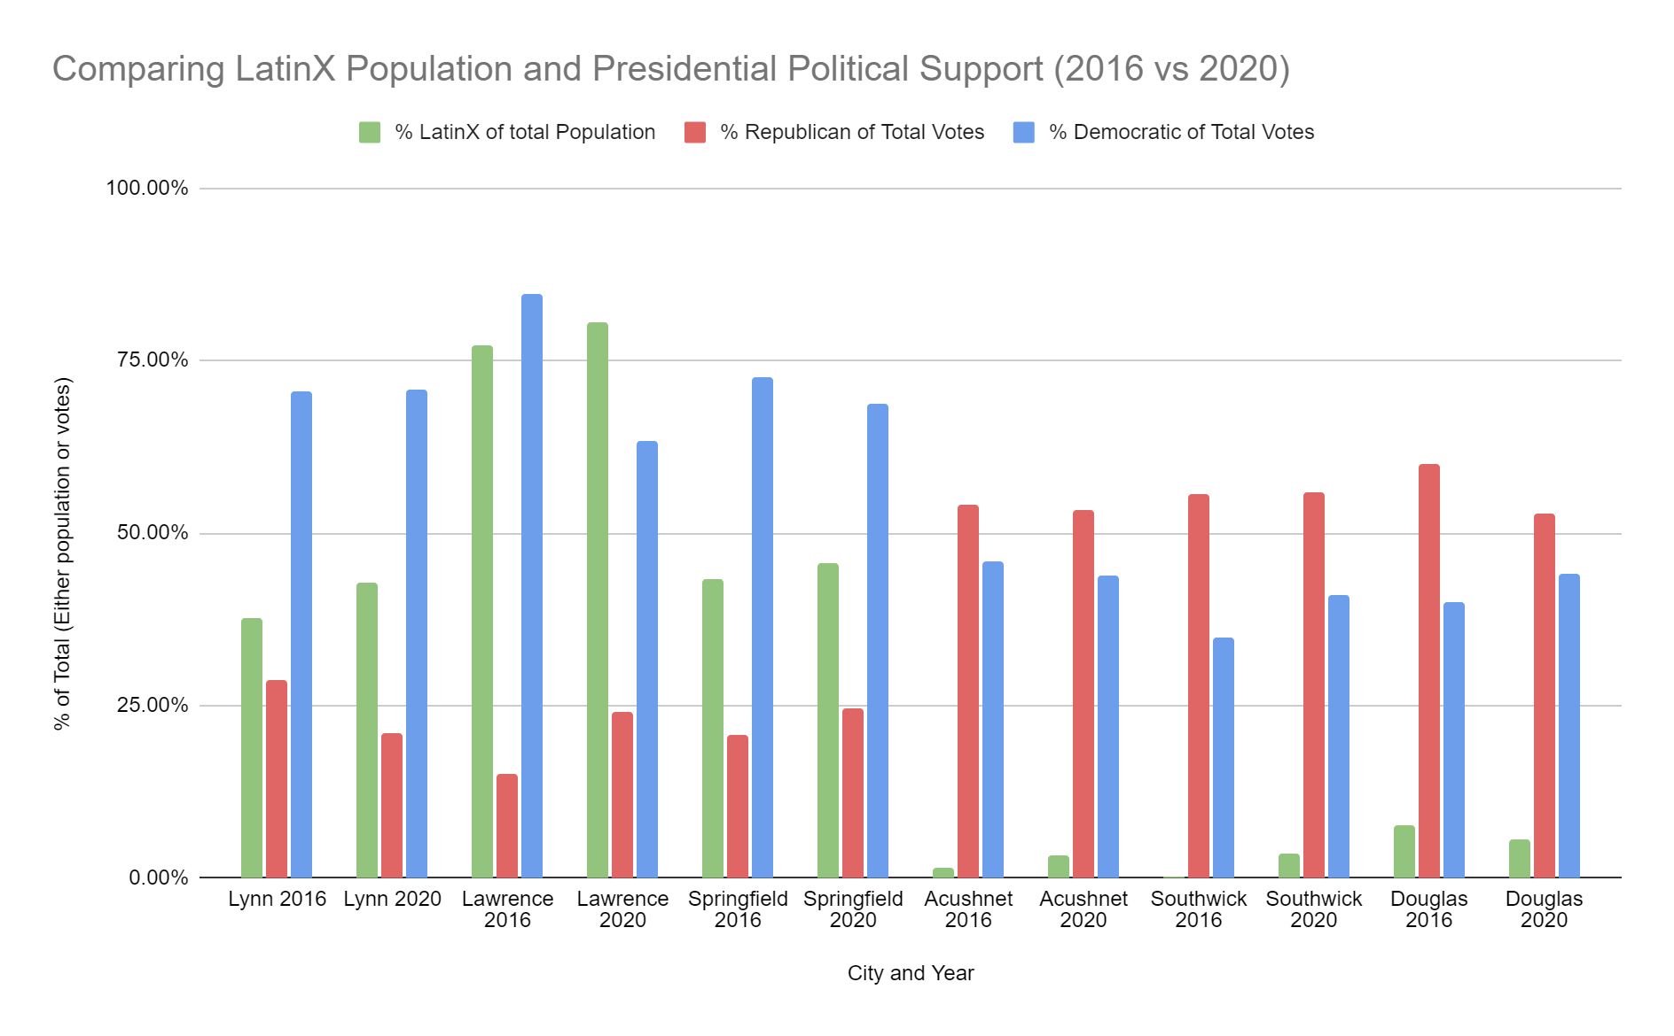
Preliminary Analysis
Geospatial Analysis of 2016 Presidential Election
LatinX Population vs Election Results (by year per city)
Notes:
Changes in LatinX demographics do not seem to affect Democratic or Republican voting patterns
However, this is only for 6 cities in MA so we cannot make conclusions based on this data alone
Over 65% support -> Dark Red or Dark Blue
50%-65% support -> Light Red or Light Blue
Else -> Grey

Slide 4
Project Limitations and Next Steps
Limitations:
No objective means to merge tract data with precinct data
Lack of explicit data that highlights which LatinX communities and subgroups voted for which candidate
Can only make indirect inferences on voting patterns based on changes in LatinX demographics
Correlation does not imply causation!
Next Steps:
Merge tract data with precinct data for all cities within Massachusetts
Perform analysis as done for our first 6 cities for all cities
Apply classification methods to find potential patterns between demographics and voting results

